Slide 1
Predicting The Most Profitable Movie Genre
Prepared by:
Khalid Bawazer

Slide 2
Introduction
Film industry considered one of the most profitable and risky businesses in the entertainment and media fields, has a massive audience and its profits are estimated in millions/billons. It’s extremely important for the filmmakers and producers to know and understand their audience preferences regarding genres.
Objectives
Examine and predict which genre of movies will win the audience reception and acceptance within upcoming years based on several factors such as profit reception, Ratings, Views, and others. This model will benefit the filmmakers, and producers in the film industry to know which kind of movies the audience prefers to watch to grant the financial return.

Slide 3
Design
The dataset is obtained from IMDb website (an acronym for Internet Movie Database), is an online database of information related to films, television programs, home videos, video games, and streaming content online – including cast, production crew and personal biographies, plot summaries, trivia, ratings, and fan and critical reviews.

Slide 4
Data
The dataset consist of two datasets combined into one, include 77 features and 85,855 observations.
Features Description
17 Categorical:
Movie ID, Movie Name, Genre, Language, Director, Budget, Gross, etc.
54 Numerical:
Duration, Average Votes, Total Votes, Number of reviews from users and critics, etc.

Slide 5
Algorithms & tools
Feature Engineering
Merging two datasets into one (Movie details and ratings).
Clean the dataset which contain null values.
Omit non-dollars movie profit records.
Converting categorical features into numerical.
Data Processing
Numpy, Pandas.
Visualizations
Matpltlib. Seaborn.
Models
K-Means Clustering.
Train Score: 62.28%
Test Score: 28.41%
Logistic regression.
Train Score: 17.19%
Test Score: 17.17%

Slide 6
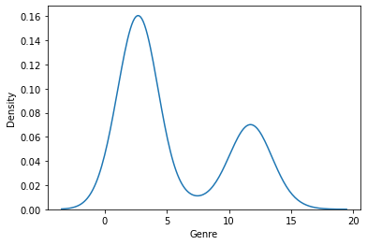

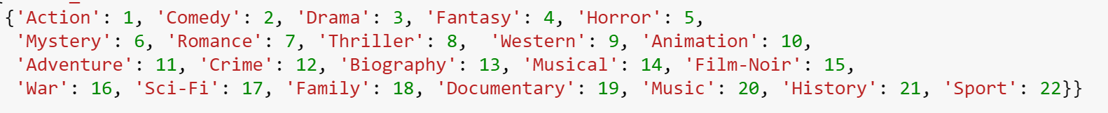
Graphs

Slide 7
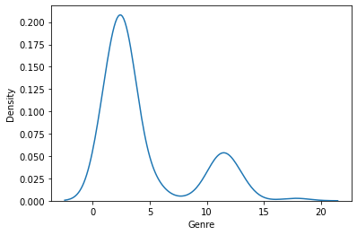

Graphs

Slide 8
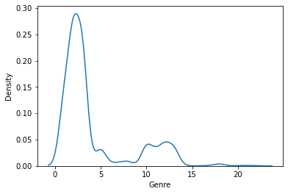
Graphs

Slide 9
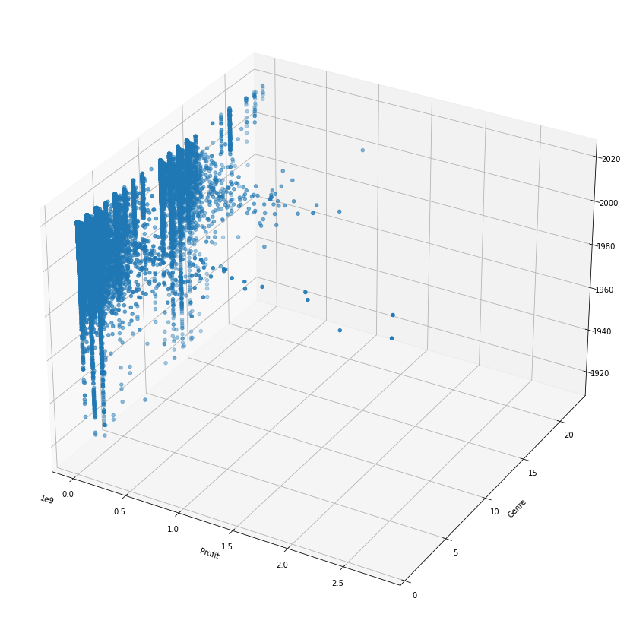
Graphs

